Slide 1
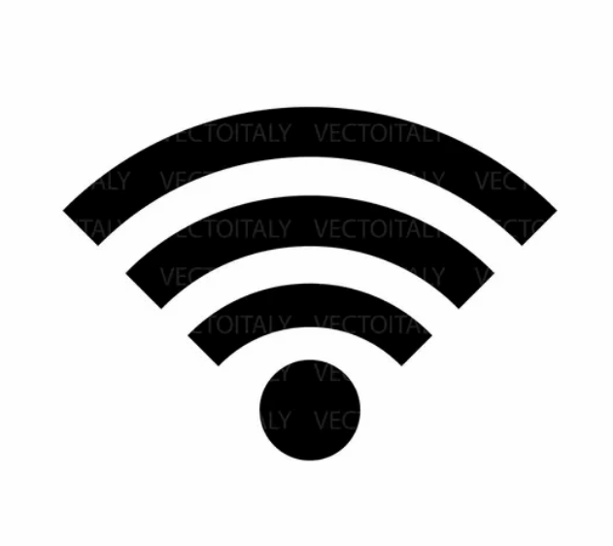

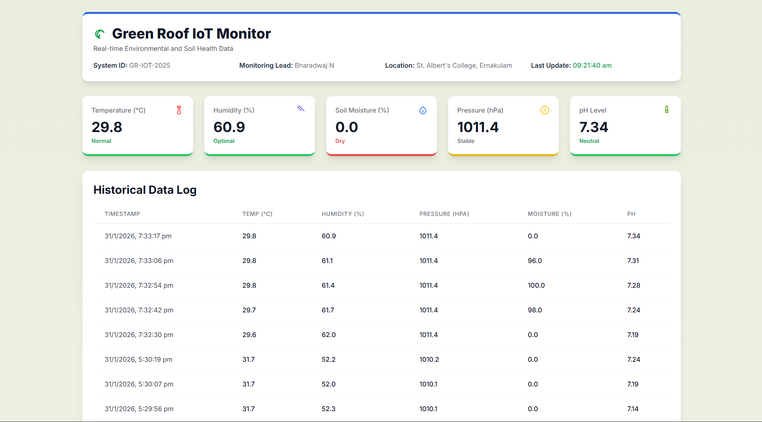
IoT Architecture Flow
Output : User Interface
Sensor Input
Soil Moisture
Surrounding Temperature
ph Value
Atmospheric Pressure
Web Server
Atmospheric Humidity
Safe Data Logging & Storage

